Slide 1
Exploring Cognitive Services
[ speaker name]
[ speaker contact methods ]
Notes:
Put your details above.
Each slide contains example script in the notes. Once confident with the content, you can use the headings in the notes as cues to ad-lib the content in your own words.

Slide 2
Cognition
the mental action or process of acquiring knowledge and understanding through thought, experience, and the senses

Slide 3
What are Cognitive Services?
Cognitive services are a set of APIs that are designed to democratize artificial intelligence by enabling systems to see, hear, speak, understand and interpret our needs using natural methods of communication.
What these services generally do is bring structured semantic data to human knowledge I/O with a degree of confidence
“A picture of Satya Nadella happy”
Image of person
Emotional readings
“x% sure that this person is [highest emotion]”
This is about a person

Slide 4
Demo
Introducing Cognitive Services
Notes:
Demo 1.1
https://aka.ms/trysentiment

Slide 5


Case Study
The “push a button, get a ride” service in more than 66 countries and 508 cities worldwide, and employs 6,700 people
Drivers take a selfie periodically to check identity
Compares photos with varying pose, focus, and lighting conditions, which is critical for uncontrolled conditions like drivers taking selfies at night in their cars
Match within milliseconds
Thousands of sign-ins every hour
Integrated with Java front-end and Go backend (with Python) in 3 weeks.
Notes:
https://www.microsoft.com/cognitive-services/en-us/applications
Uber

Slide 6
Types of Services
Vision | Speech | Language | Knowledge | Search

Slide 7
Vision
Computer Vision
Content Moderator
Emotion
Face
Video

Slide 8
Speech
Bing Speech
Custom Speech Engine
Speaker Recognition

Slide 9
Language
Bing Spell Check
Linguistic Analytics
Text Analytics
Translator
WebLM
Language Understanding

Slide 10
Knowledge
Academic
Entity Linking
Knowledge Exploration
QnA Maker
Recommendations

Slide 11
Search
Bing Autosuggest
Bing Image Search
Bing News Search
Bing Video Search
Bing Web Search

Slide 12
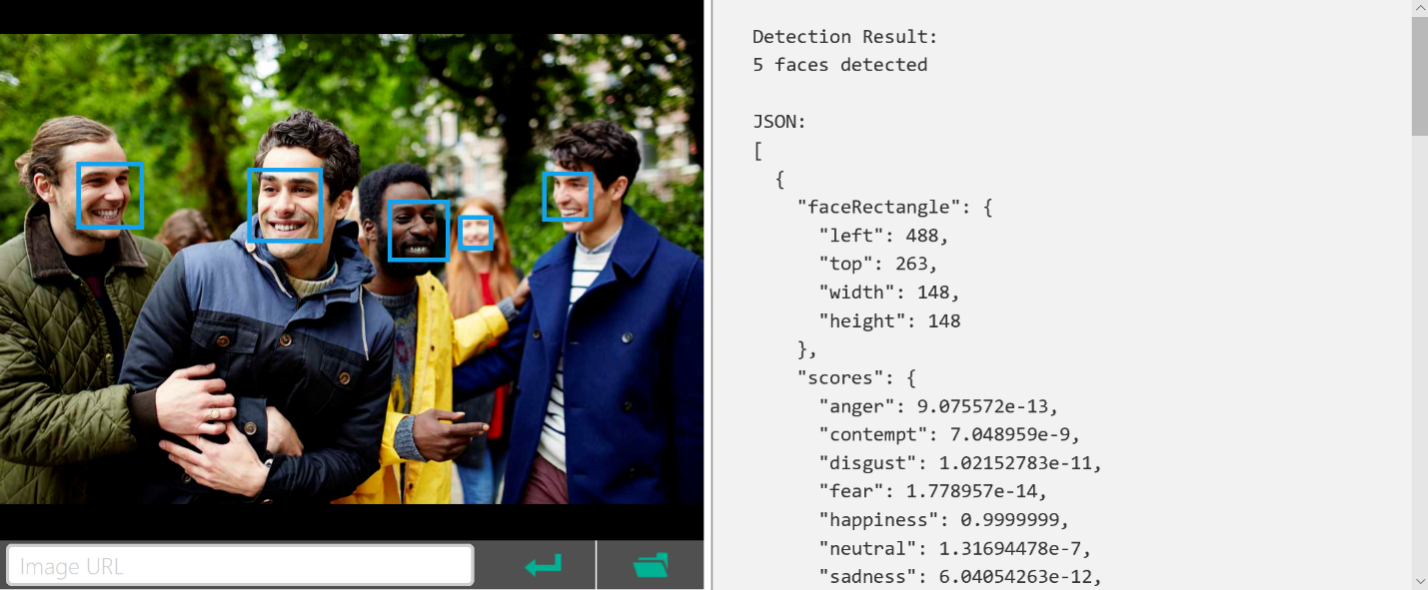
REST/JSON-based Services

Slide 13
Languages & Runtimes
Any runtime supporting REST calls
Any language that can parse through data
General there is a serializer between them – Json.NET or NPM package

Slide 14
Demo
Calling Cognitive Services
Notes:
Demo 1.2

Slide 15
Getting Started
General free trials
Regular subscriptions managed through Azure
Use Visual Studio to Paste JSON as a class
Must keep keys safe, so do not store in client applications

Slide 16
Scenario – A Researcher
Request a picture of a thing by voice
Determine that this is for a thing
Get image to display
“Show me a picture of a table”
This is about a thing
Image of table
Request a picture of a person (with a specific emotion) by voice
Determine that this is for a person
Get image to display
Find emotions of person in picture
Be told the highest emotion and confidence
“A picture of Satya Nadella happy”
This is about a person
Image of person
Emotional readings
“x% sure that this person is [highest emotion]”

Slide 17
Demo
Researcher App
Notes:
Demo 1.3

Slide 18
Scenario Services Solution
Request a picture of a thing or person (with a specific emotion) by voice
Determine intent for thing or person
Get image to display
Find emotions of person in picture
Be told the highest emotion and confidence
STT
LUIS
Image Search
Emotion
TTS
“A picture of Satya Nadella happy”
This is x% about a thing/person
Image of person
Emotional readings
“x% sure that this person is [highest emotion]”

Slide 19


Starship Commander
A VR game with interactive character experiences powered by voice where player actions determine story.
Used Custom Speech Service allowing for fictional names and phrases, and training custom script.
Overcame barriers around speaking style, background noise & vocabulary – cut error rate in half.
Service is available for future platorm expansion
Players speak their mind, so LUIS helps determine their intent
Notes:
https://www.microsoft.com/cognitive-services/en-us/applications
Starship Commander

Slide 20
Summary
Explored services that bring structured semantic data to human knowledge I/O with a degree of confidence
Saw examples of companies using these services
Learned the basics of getting connected
Saw an example of multiple services working together for a specific scenario

Slide 21
Resources
Further sessions in this series:
Starting Cognitive Services – The building blocks and services behind the Research app
Learn and try at - https://www.microsoft.com/cognitive-services
Docs & getting started - https://docs.microsoft.com/en-us/azure/cognitive-services/
Cognitive Services example code - https://github.com/Microsoft/Cognitive-Samples-IntelligentKiosk
Notes:
As shown

